Slide 1

Ensemble Methods: Boosting and BART
This lecture corresponding to textbook sections 8.2.3 -8.2.5
Intro to Statistical and Machine Learning
Duo Yu
October 24, 2023

Slide 2
Boosting
Like bagging, boosting is another ensemble approach that can be applied to many statistical learning methods for regression or classification.
Bagging involves creating multiple copies of the original training data set using the bootstrap, fitting a separate model (tree) to each copy, and then combining all models (trees) to create a single predictive model.
Boosting does not involve bootstrap sampling; instead each model is built (tree is grown) sequentially on a modified version of the original data set.

Slide 3
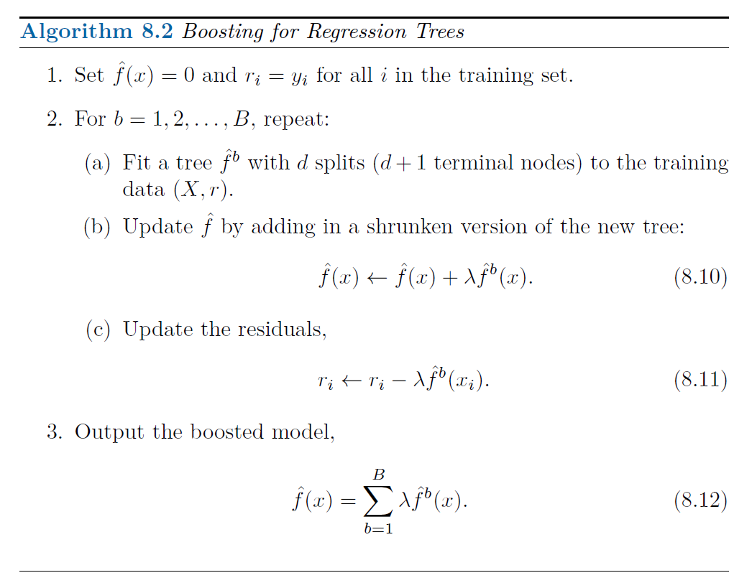

Slide 4

Q1: When the tree depth $d=1$, is the boosting tree an additive model? Write the formula.

Slide 5
Why does boosting work?
Intuitively, at each iteration, the new base learner reduces the residual (or the loss function) based on the previous learner.
But boosting can be derived through solid statistical framework.
Friedman et al. 2000 and Friedman et al. 2001 established a connection between boosting algorithm with statistical framework, a gradient-boosting based formulation of boosting methods was derived and proposed gradient boosting machine.
In gradient boosting machine, or GBM, at each iteration, a new base learner is constructed to be maximally correlated with the negative gradient of the loss function.

Slide 6
Boosting for classification
Boosting for classification is similar in spirit to boosting for regression
The R package gbm (gradient boosted models) handles a variety of regression and classification problems.

Slide 7
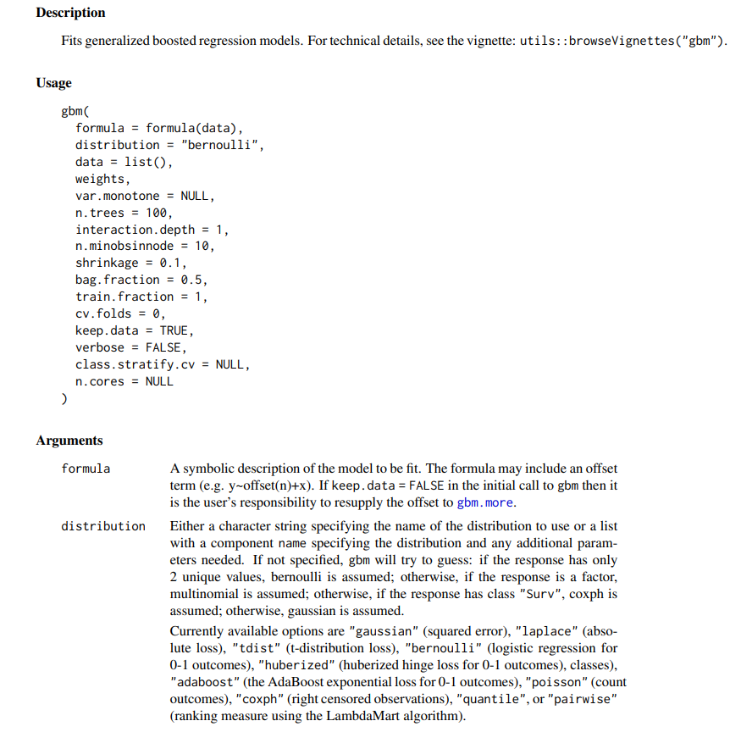
The gbm R package and gbm function.
The distribution option allow user to fit different problems based on the distribution of response which is related to different loss function.

Slide 8
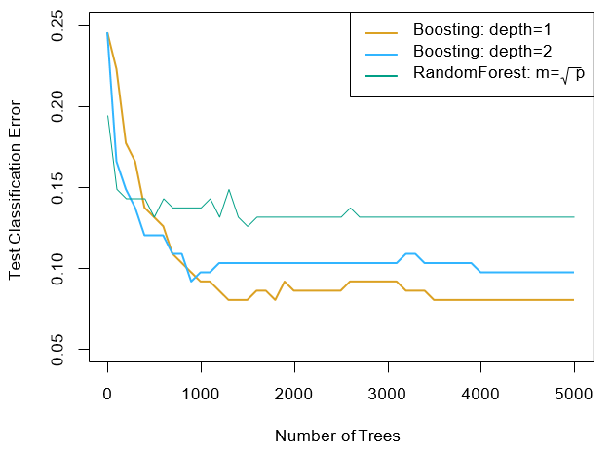
Example: Gene expression data
Results from performing boosting and random forests on the fifteen-class gene expression data set to predict cancer (14 cancer classes) versus normal.
The test error is displayed as a function of the number of trees. For the two boosted models, λ=0.01. Depth-1 trees slightly outperform depth-2 trees, and both outperform the random forest, although the standard errors are around 0.02, making none of these differences significant.
The test error rate for a single tree is 24%.

Slide 9
Tuning parameters for boosting
The number of trees B. Unlike bagging and random forests, boosting can overfit if B is too large, although this overfitting tends to occur slowly if at all. We use cross-validation to select B.
The shrinkage parameter λ, a small positive number. This controls the boosting learning rate. Typical values are 0.01 or 0.001, and the right choice can depend on the problem. Very small λ can require using a very large value of B to achieve good performance.
The number of splits d in each tree, which controls the complexity of the boosted ensemble. Often d =1 works well, in which case each tree is a stump, consisting of a single split and resulting in an additive model.

Slide 10
Q 2. To perform boosting tree, we need to select 3 parameters: number of samples B, tree depth d, and step size λ. How many parameters do we need to select to perform Random Forests?

Slide 11
Ensemble summary
Ensemble combine classifiers to improve performance
Bagging
Reduce variance (large ensemble cannot cause overfitting)
Bias is not changed (much)
Parallel
Aim to minimize correlation between ensemble elements
Boosting
Reduce bias
Increase variance (large ensemble can cause overfitting)
Sequential
High dependency between ensemble elements

Slide 12
Bayesian Additive Regression Trees (BART)
Another ensemble method that uses decision trees as its building blocks.
Relates to both bagging and boosting in tree growing

Slide 13
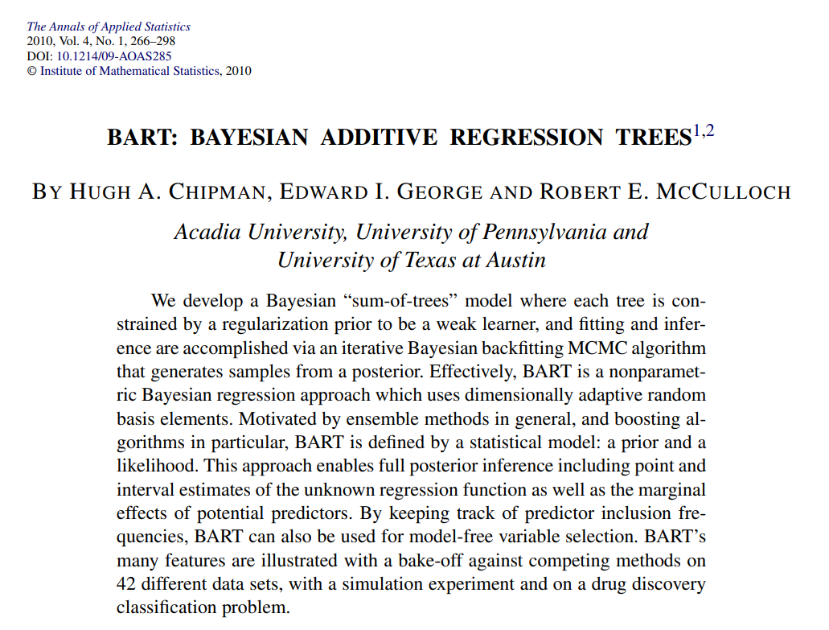
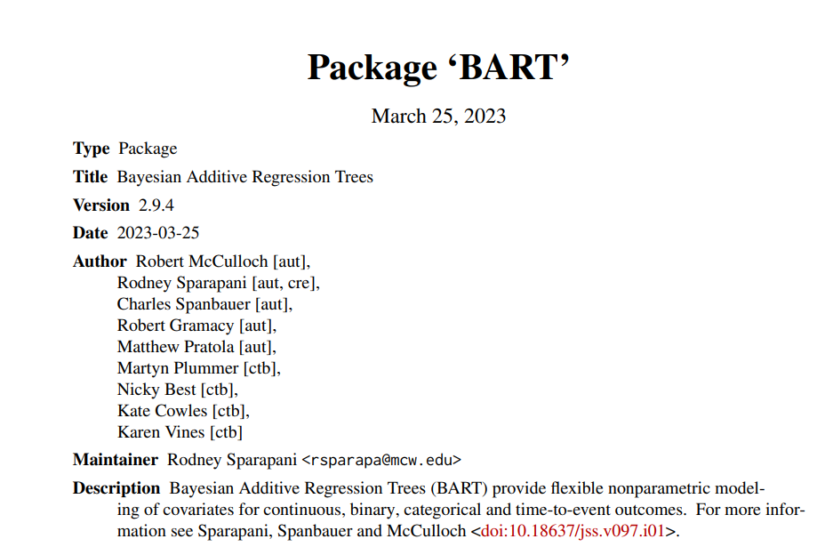

Slide 14
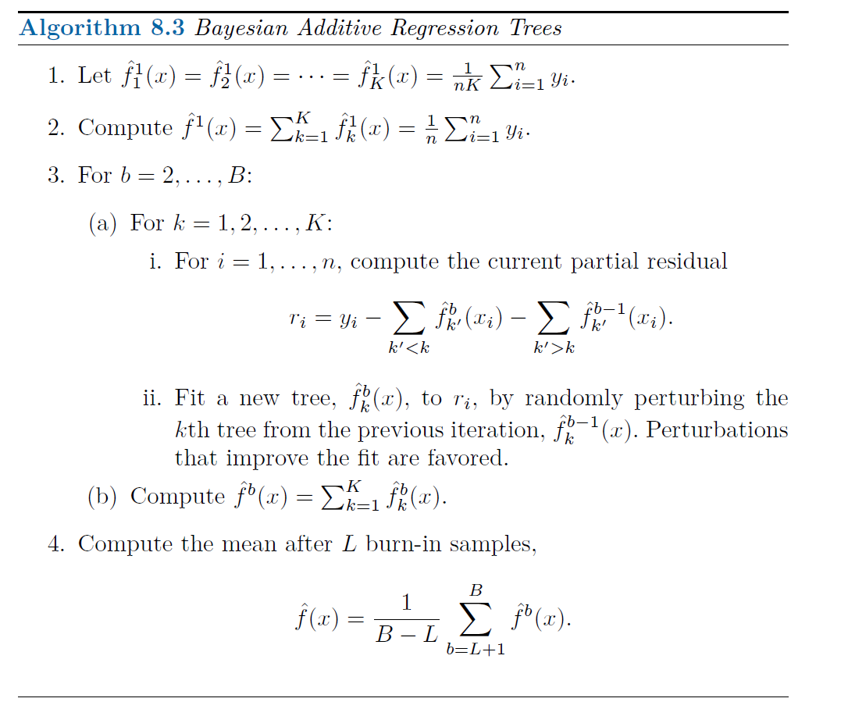
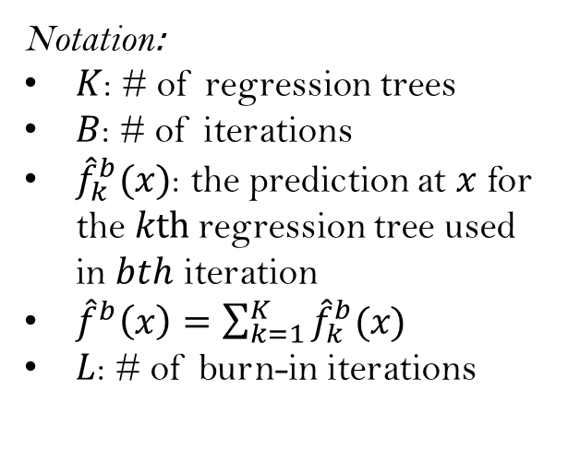
Notation:
$K$: # of regression trees
$B$: # of iterations
${\hat{f}}_{k}^{b}(x)$: the prediction at $x$ for the $kth$regression tree used in $bth$ iteration
${\hat{f}}^{b}\left(x\right)=\sum_{k=1}^{K}{{\hat{f}}_{k}^{b}(x)}$
$L$: # of burn-in iterations

Slide 15




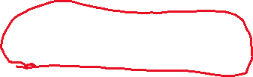

Slide 16
Tree perturbation in BART
Two components:
Change the structure of the tree, adding or pruning branches
Change the prediction in each terminal node

Slide 17
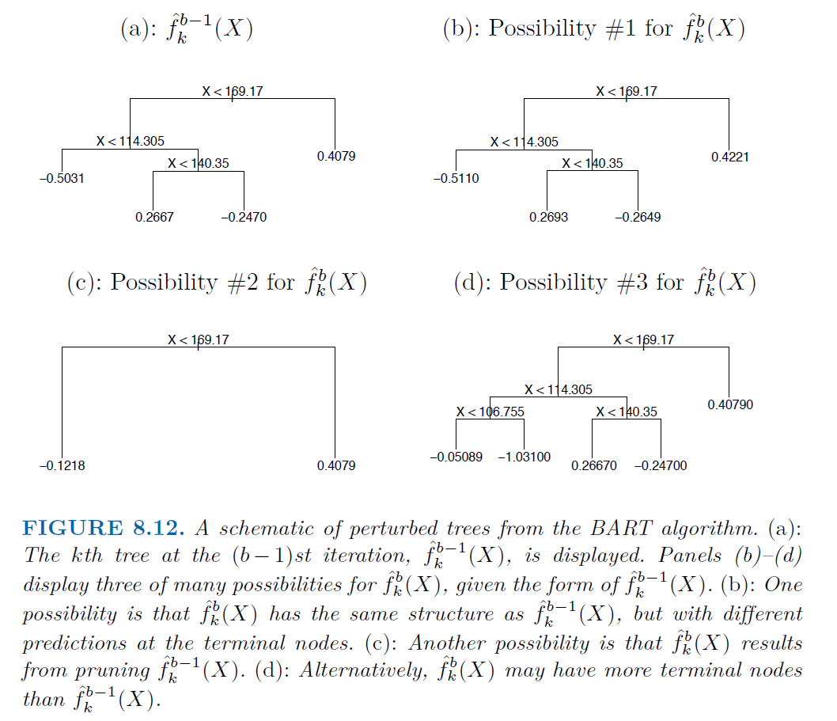
Change predictions
Perturbation in BART example
Pruning a branch
Adding a branch

Slide 18
How does BART combine ideas of bagging and boosting?
Bagging and RF build tree independently
Boosting build tree sequentially, each tree aims to further reduce the residual from the previous trees
BART:
Build tree independently based on X and current residual (different tree use different data)
Random grow individual trees by random perturbation
Sequentially grow tree aims to reduce the residual from previous iteration

Slide 19
How does BART avoid over-fitting?
The key is tree perturbation!
At each iteration, it does not fit a fresh tree to current residual.
It improve the fit by slightly modifying the tree from previous iteration.
Furthermore, each individual tree is typically small.
It sequentially reduces bias without increasing much of variance.

Slide 20
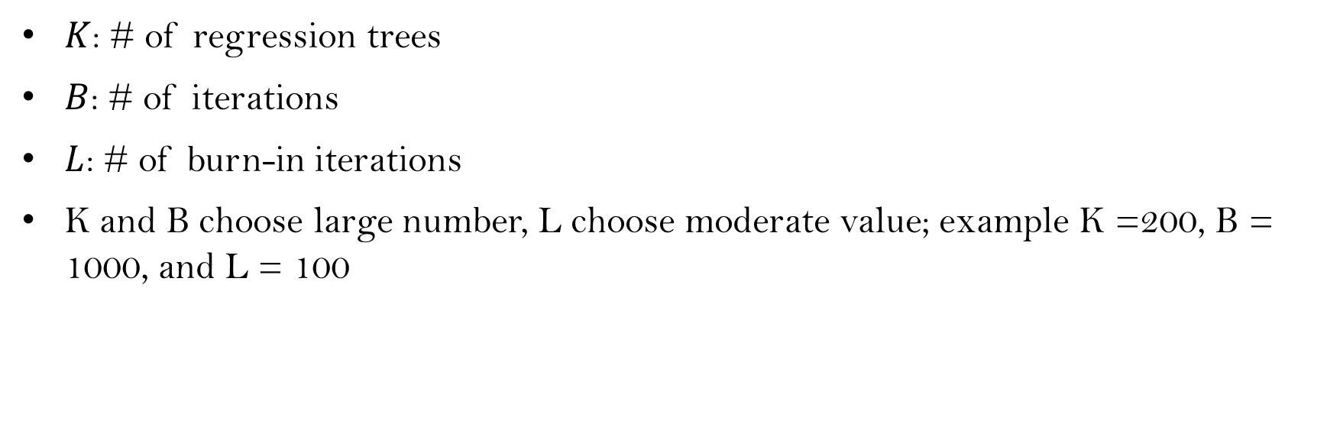
Tunning parameters of BART
$K$: # of regression trees
$B$: # of iterations
$L$: # of burn-in iterations
K and B choose large number, L choose moderate value; example K =200, B = 1000, and L = 100

Slide 21
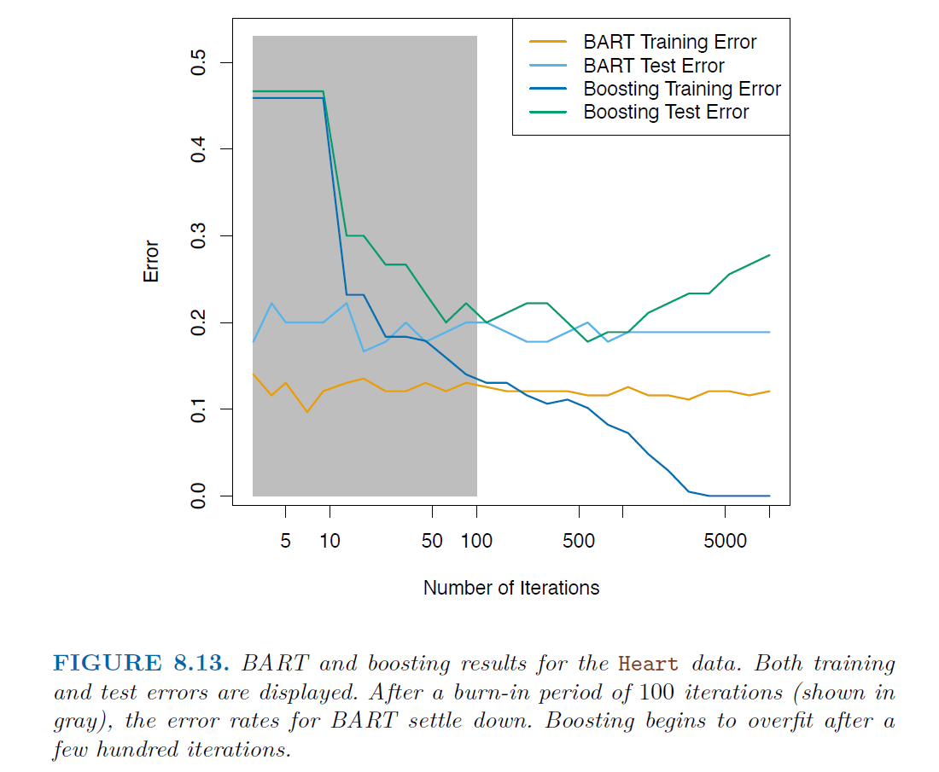
BART example
Heart data
K = 200
The similarity in training and testing error in BART indicates the tree perturbation process largely avoids overfitting

Slide 22

BART from Bayesian perspective
Given prior of each tree and observed data
At each iteration, randomly perturbing a tree is equivalent to drawing a new tree from a posterior distribution
The whole algorithm is equivalent to run backfit MCMC for BART
More detail on paper: Hugh A. Chipman, Edward I. George, Robert E. McCulloch "BART: Bayesian additive regression trees," The Annals of Applied Statistics, Ann. Appl. Stat. 4(1), 266-298, (March 2010)

Slide 23
Summary
Bagging, grow trees independently on random samples, tend to grow similar trees, can get caught in local optimal and fail to explore the whole model space.
Random forests, grow tree independently on random samples, each split on each tree is performed using a random subset of the predictors, thereby decorrelating the trees, lead to a more thorough exploration of model space relative to bagging.
Boosting, only use the original data, do not draw any random samples. Grow trees successively, using a “slow” learning approach: each new tree is fit to the signal that is left over from the earlier trees, and shrunken down before it is used.
BART, only use the original data, grow tree successively. However, each tree is perturbed to avoid local minima and achieve a more thorough exploration of the model space

